Slide 1
Cryptography Simplified Anshul Gupta
Thales Learning Partners

Slide 2

Anshul Gupta Distinguished Technical Lead DES, MCS
Your Profile
PDA/PLA – Cloud OTA
8+ years of experience
Security Enthusiast
Security Champion – Secure Code Warrior
Avid Reader

Slide 3
Agenda of the program
Day 1
Introduction to Cryptography
Classical Cryptography
Symmetric Cryptography
DES
3DES
AES
Block Ciphers Mode of operations
Day 2
Asymmetric Cryptography - Introduction
Encryption/Decryption
Algorithms
RSA Algorithm
ECC
DHKE
Digital Signatures
Digital Certificates
Thales PKI
Day 3
PKCS Standards
PGP
Hash Functions
Use Cases
Transport Layer Security
SSH Communication
Outlook Sign/Encrypt
Future Trends

Slide 4
Prerequisites
Laptop
OpenSSL installed
GPG installed
Zeal for learning

Slide 5
What is Cryptography ?
Cryptography is the art and science of secure communication.
It involves the study of techniques for constructing and analyzing protocols that enable the confidentiality, integrity, and authenticity of information, even in the presence of malicious adversaries.

Slide 6

How did Cryptography originate?
One of the greatest inventions of all time that propelled Homo sapiens to further evolve is communication.
This is the one of the inherent needs for Human being, other being to communicate selectively and secretly.
This gave birth to Cryptography.

Slide 7



A BRIEF HISTORY
The origins of cryptography can be traced back to ancient kingdoms.
As civilizations evolved, human beings got organized in tribes, groups, and kingdoms.
This led to the emergence of ideas such as power, battles, supremacy, and politics.
These ideas further fueled the natural need of people to communicate secretly with selective recipient which in turn ensured the continuous evolution of cryptography as well.

Slide 8
Classical Cryptography
Classical cryptography encompasses historical methods that often relied on simpler substitution and transposition techniques.

Slide 9


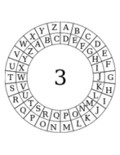

CLASSICAL CRYPTOGRAPHY
Hieroglyphs (Egyptian)
Scytales (Spartans)
Caesar Cipher (Julius Caesar)
Enigma (WW2)

Slide 10
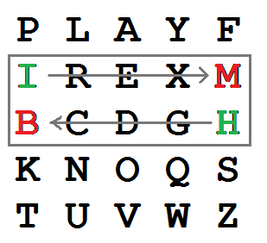
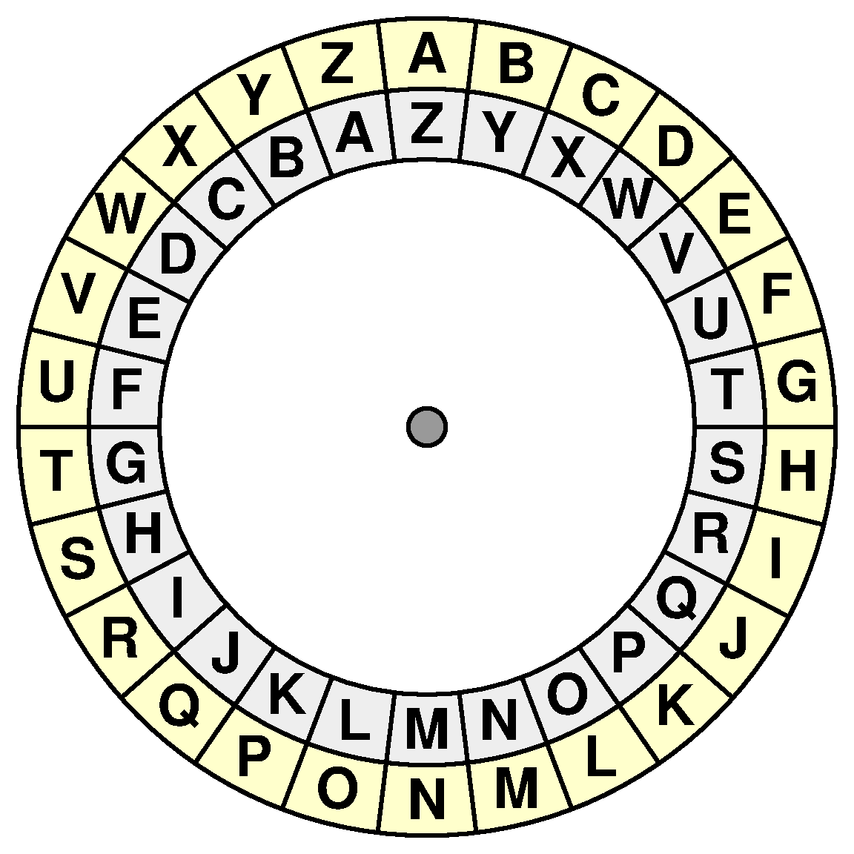
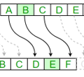
Substitution Ciphers
Substitution ciphers are a type of cryptographic technique where each letter in the plaintext is replaced by another letter or symbol according to a fixed system.
In a substitution cipher, the letters of the plaintext are mapped to new letters, numbers, or symbols based on a predetermined key or rule.
Examples
Caesar Cipher
Atbash Cipher
Playfair Cipher

Slide 11
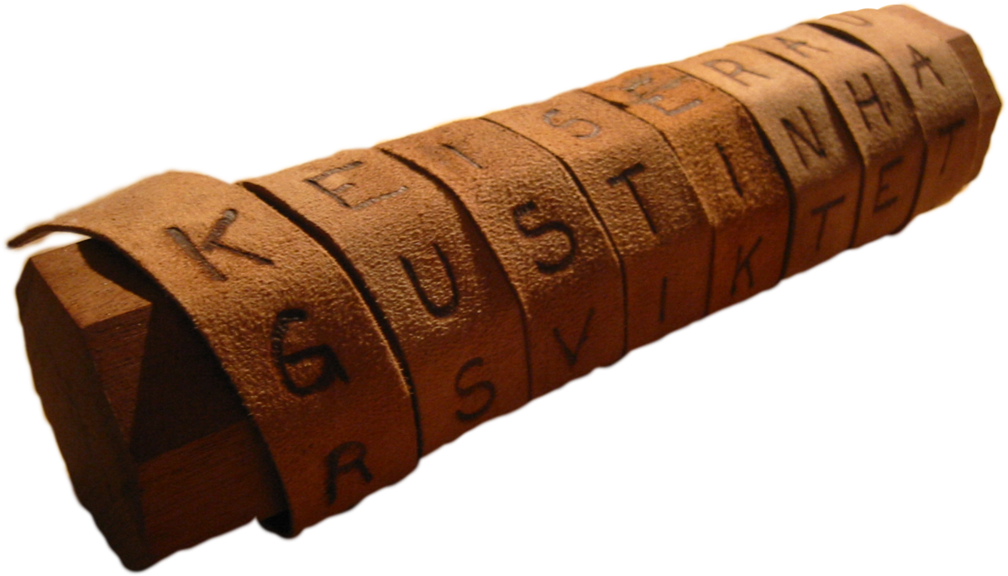

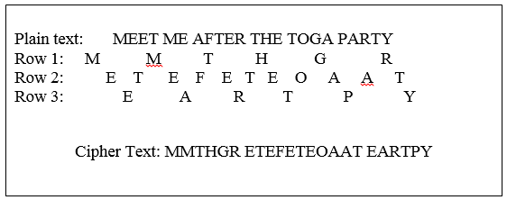
Transposition (Permutation) Ciphers
Transposition ciphers are a type of cryptographic technique where the characters in the plaintext are rearranged according to a specific rule.
The actual characters themselves are not substituted or changed.
Order of the characters is altered to create the ciphertext
Examples
Rail Fence Cipher
Scytale
Columnar Transposition

Slide 12
Why do we need Cryptography?
Confidentiality
data remains private and hidden from un-authorized access.
Integrity
data has not been tampered with or altered with during transmission or storage.
Authentication
ensures the identity of sender or receiver of data.
Non-Repudiation
sender cannot deny the authenticity of a message they have sent.

Slide 13
Modern Cryptography
Modern cryptography refers to contemporary techniques of securing digital data through complex mathematical algorithms and protocols, ensuring robust protection against unauthorized access or manipulation.

Slide 14
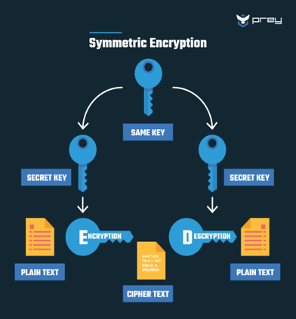
Symmetric Cryptography
Symmetric cryptography, also known as secret-key cryptography, is a fundamental technique in the field of cybersecurity.
single key used – also known as shared secret, shared between sender and receiver.
Highly Efficient.
Also known as Private Key Cryptography.
Algorithms
DES – Data Encryption Standard
3DES – Triple DES
AES – Advance Encryption Standard

Slide 15
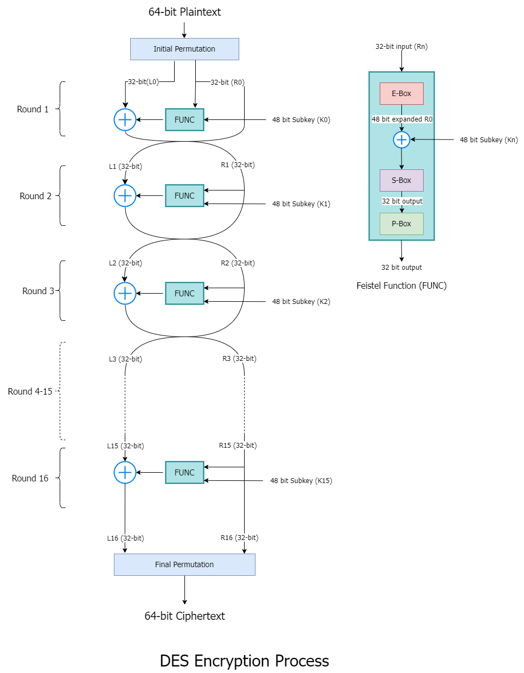
Data Encryption Standard (DES)
Conceived by IBM in the early 1970s and later adopted as a US federal standard.
Symmetric-Key Encryption – shared secret
Block Cipher – works on 64-bit blocks
64-bit (56-bit without parity bits) key size
Feistel Network structure – 16 rounds
Key schedule algorithm – generate a set of 16 subkeys from original key, each 48-bit long
Very weak, many attacks available, can be broken in 22 hours
https://anshulgupta.dev/blog/2023/09/27/demystifying-des-a-deep-look/

Slide 16
DES – Hands ON
Refer - https://github.com/heartofrevel/CryptographySimplified
Section 1

Slide 17
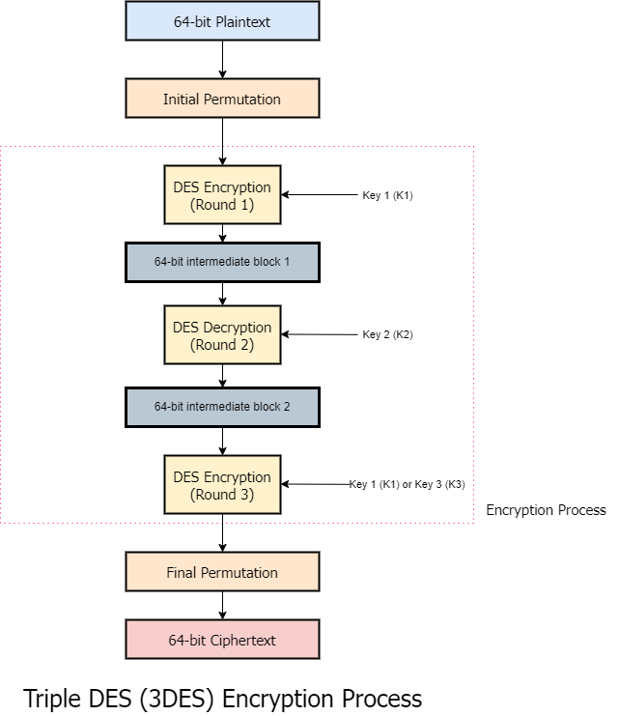
Triple DES (a.k.a. 3DES/TDEA)
symmetric key algorithm, meaning the same key is used for both encryption and decryption
fundamental idea behind 3DES is to apply the DES algorithm three times consecutively to each data block
two or three different keys i.e. 128 bit (3DES-2) or 192 bit (3DES-3)
More resistant to brute force attacks as compared to DES.
Compatible with DES systems
Not considered secure anymore, attacks like Meet in the Middle, Chosen Plaintext Attack exist
https://anshulgupta.dev/blog/2023/11/18/triple-des-3des-the-trusted-sentry-of-cybersecurity/

Slide 18
3DES – Hands ON
Refer - https://github.com/heartofrevel/CryptographySimplified
Section 2

Slide 19
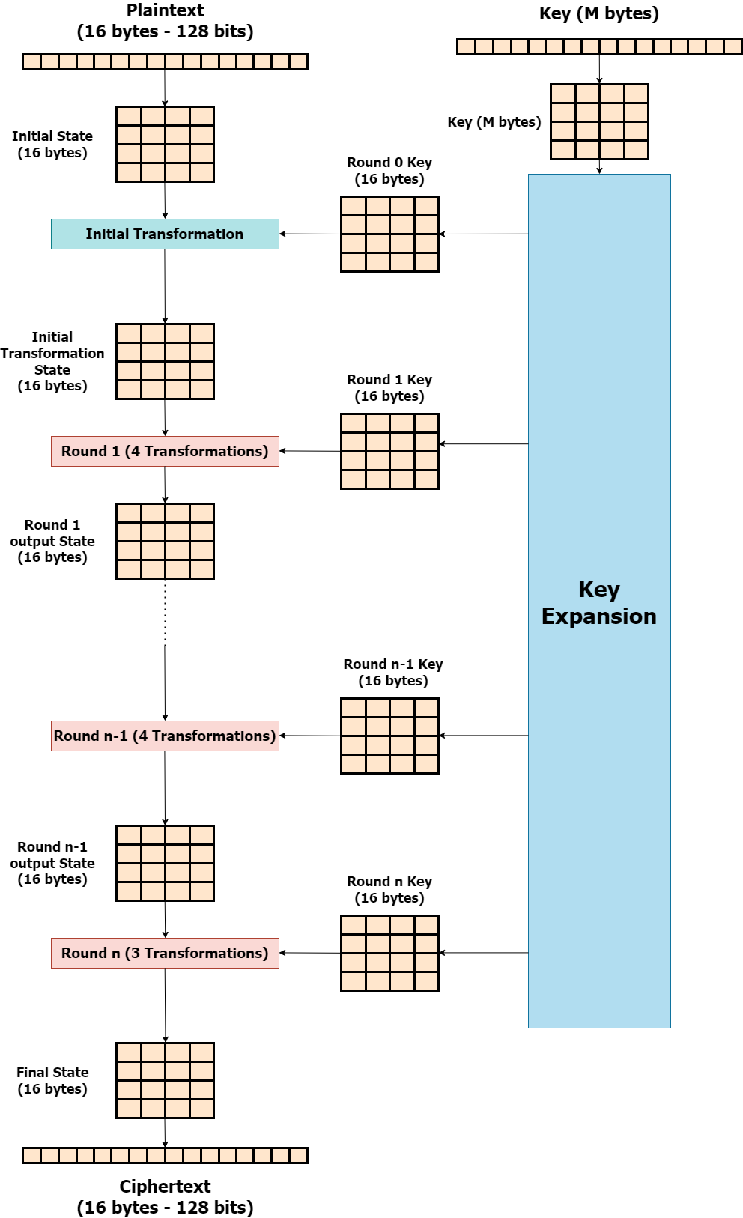
Advanced Encryption Standard (AES)
symmetric key algorithm, meaning the same key is used for both encryption and decryption
Block size – 128 bits
Key sizes – 128, 192, 256 bits
Rounds – 10, 12, 14
Works using Substitution Permutation Network (SPN)
Efficient in both hardware and software implementations.
Highly secure against all known attacks when used with a proper key size.
https://anshulgupta.dev/blog/2024/02/11/advanced-encryption-standard-aes-algorithm-a-deep-dive/

Slide 20
AES – Hands ON
Refer - https://github.com/heartofrevel/CryptographySimplified
Section 3

Slide 21

Block Cipher Mode of Operations
Cipher Feedback (CFB)
turns block cipher into stream cipher
previous ciphertext block is used as input to block cipher along-with key
complex to implement
Output Feedback (OFB)
turns block cipher into stream cipher
output of block cipher is fed as input to next iteration along-with key
complex to implement
support parallelization
Counter (CTR)
turns block cipher into stream cipher
counter is initialized and incremented in each iteration
counter is fed as input to block cipher along-with key
deterministic
support parallelization
Electronic Codebook (ECB)
each plaintext block is ciphered separately.
simple – easy to use
supports parallelization
lack of security – doesn’t hide patterns
Cipher Block Chaining (CBC)
previous ciphertext block is XORed with plaintext block
randomization - Initialization Vector (IV) is used
error protection
hide patterns

Slide 22
Block Cipher Mode of Operations – Hands ON
Homework

Slide 23
Symmetric Cryptography - Challenges
Key Distribution
Most significant challenge is securely distributing the secret key to all authorized parties
Key Management
As the number of users and devices increases in a network, managing and updating secret keys becomes complex and resource-intensive. Key rotation and revocation can be challenging to implement securely.
Scalability
Becomes less practical as the number of communicating parties increases. Each pair of users requires a unique secret key, resulting in a quadratic increase in the number of keys needed for secure communication.
Lacking non-repudiation
Symmetric encryption alone cannot prevent a sender from denying their involvement in a communication because the same key is used for both encryption and decryption.

Slide 24
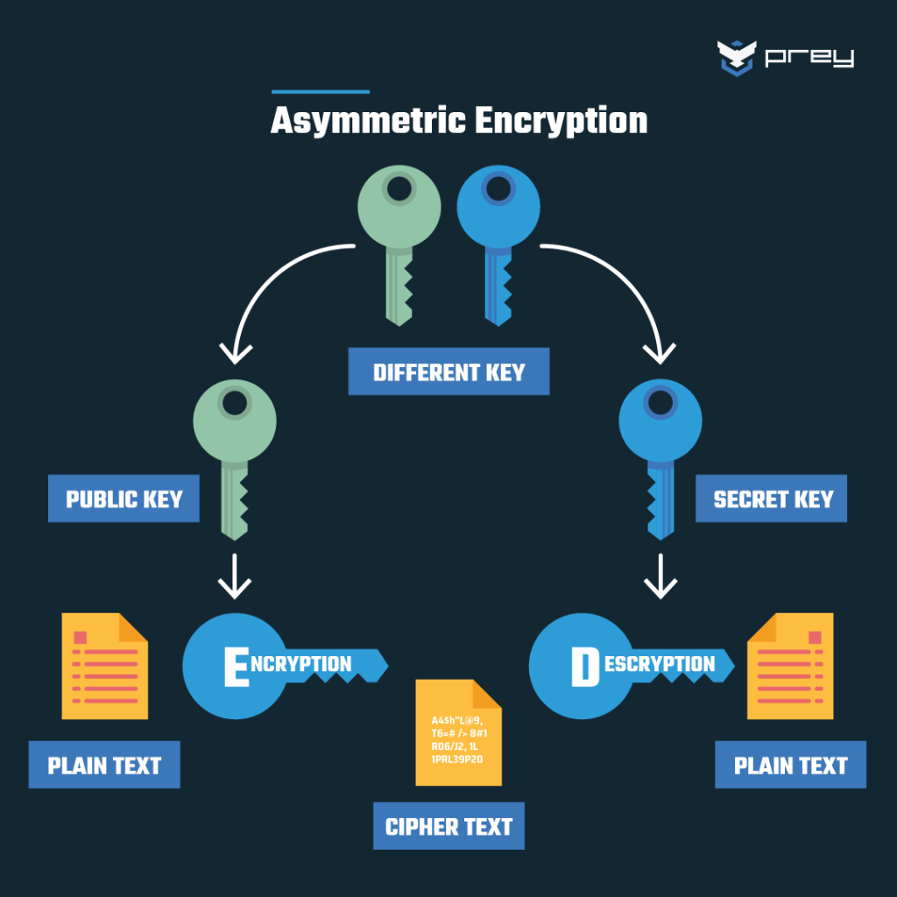
Asymmetric Cryptography
Asymmetric cryptography, also known as public key cryptography, is a fundamental technique in the field of cybersecurity.
pair of keys used – public and private
public key is widely shared – used by anyone to encrypt message meant for key’s owner
private key is private – only owner has it – used to decrypt messages that have been encrypted with corresponding public key
Advantages like secure key exchange, digital signature for authentication and non-repudiation
Algorithms
RSA
ECC
DHKE

Slide 25
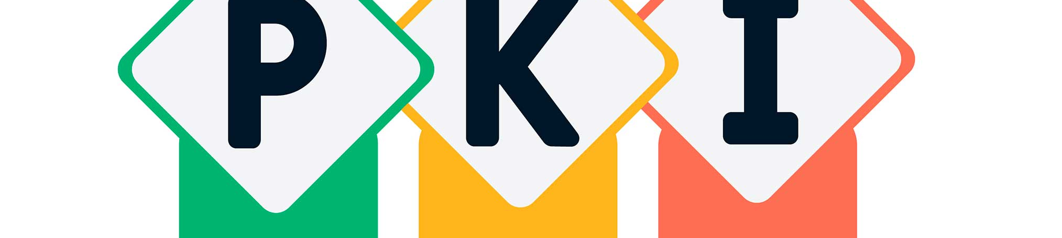
Public Key Infrastructure
comprehensive framework of policies, processes, technologies and standards.
used for securing digital communication and enabling trust in electronic transactions.
revolves around the use of asymmetric cryptography to manage digital keys and certificates for various purpose.
operates on the principal of confidentiality, integrity, authentication and non-repudiation.

Slide 26
PKI – Key Components
Private Key
counterpart to the public key.
kept secret by the key owner and never shared with anyone.
used to decrypt data that has been encrypted with corresponding public key.
used to create digital signatures, which provides authentication and non-repudiation.
Public Key
part of an asymmetric key pair.
freely shared with others.
used to encrypt data meant for key’s owner.
used to verify digital signature.

Slide 27
PKI – Key Components
Certificate Authority (CA)
trusted third-party organizations responsible for issuing, revoking, and managing digital certificates.
play a central role in establishing trust in PKI.
Digital Certificates
documents issued by trusted Certificate Authorities (CAs).
bind a user's public key to their identity.
used for authentication.
can be used for secure key exchange.

Slide 28
Asymmetric – ENCRYPTION/DECRYPTION
Used to communicate securely.
Sender encrypts the electronic document with recipient’s(receiver) public key.
Receiver decrypts the electronic document with his/her own private key.

Slide 29
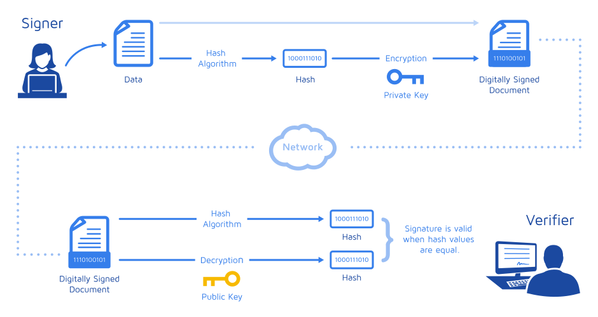
Digital Signature
Mathematical scheme used to authenticate the sender.
Represents content of the document and identity of owner.
Provide authenticity, integrity and non-repudiation to electronic documents.
Documents are signed by private key of sender and verified by public key of sender.

Slide 30
Digital Certificates
Digital certificates are electronic credentials that bind the identity of the certificate holder to a pair of cryptographic keys (public and private keys). They are used to secure online communication by providing authentication, confidentiality, and integrity.
Process
Issuance by a certificate authority: The CA verifies the identity of the certificate applicant and issues a digital certificate containing the applicant's public key and identity information.
Binding of public key to an identity: The digital certificate binds the public key to a specific identity, such as a domain name, email address, or organization.
Verification of certificate authenticity: Parties communicating over the internet can verify the authenticity of a digital certificate by checking its digital signature against the CA's public key.

Slide 31

Rivest Shamir Adleman (RSA)
Developed in 1977 by Ron Rivest, Adi Shamir, and Leonard Adleman.
RSA involves the generation of public and private keys.
Breaking RSA requires factoring the modulus n into its prime factors which is very difficult.
Larger key sizes (e.g., 2048 bits or more) enhance security against brute-force attacks.
Applications – Secure Communication SSL/TLS, Digital Signatures
Hands-on – Section 4 at https://github.com/heartofrevel/CryptographySimplified
Refer https://www.geeksforgeeks.org/rsa-algorithm-cryptography/

Slide 32
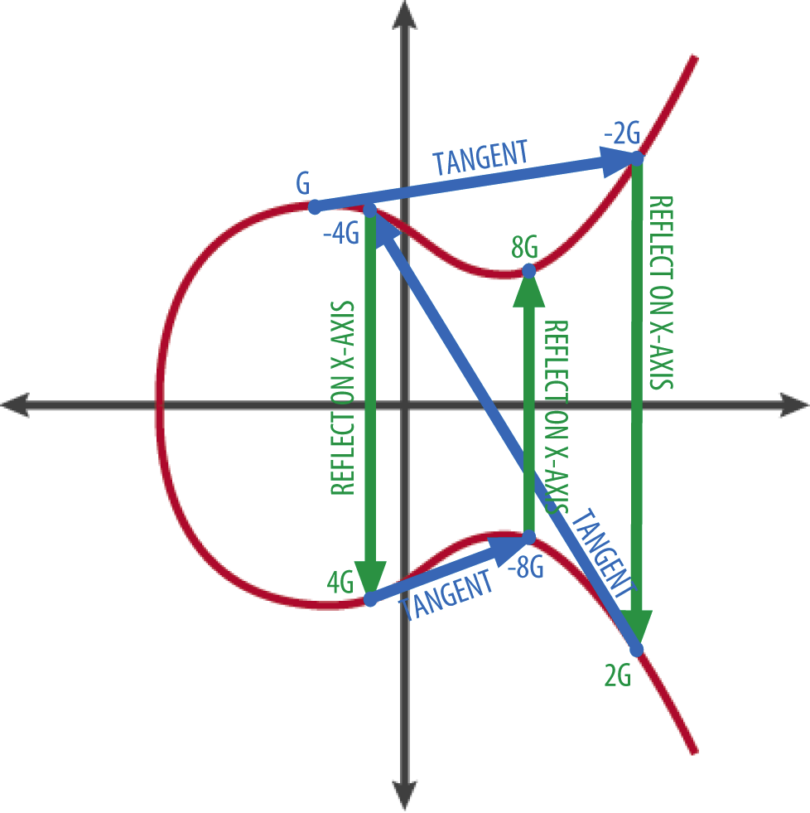
Elliptic Curve Cryptography
public key cryptography
strong security with shorter key lengths
relies on the algebraic structure of elliptic curves over finite fields
relies on the difficulty of the elliptic curve discrete logarithm problem (ECDLP)
widely used in various applications
TLS/SSL for HTTPS
Digital Signatures
Key exchange protocols
Refer https://www.keyfactor.com/blog/elliptic-curve-cryptography-what-is-it-how-does-it-work/

Slide 33
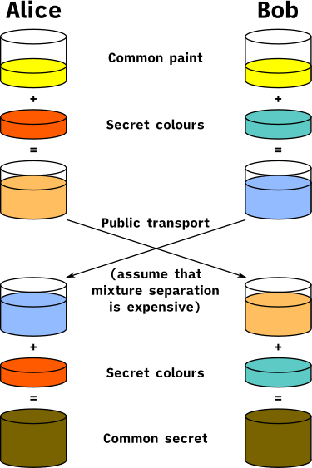
Diffie Helman Key Exchange
cryptographic protocol that allows two parties to establish a shared secret key over an insecure channel.
relies on the principles of public key cryptography. Each party has a private key kept secret and a public key shared openly.
shared secret is generated by each party independently. They combine their own private key with the other party's public key.

Slide 34
Thales PKI
Thales has its own certificate authority which can be used to sign and issue certificate for various usage.
Certificates can be issued for DEV, TEST or PRODUCTION purpose.
User would need to generate a private key and then a Certificate Signing Request and then upload the CSR to Thales PKI portal, defining few extra details along-with the CA which will be used to sign the certificate.
Concerned people will then approve the request and a signed certificate with CA chain will be sent via email.
Portal Link: https://ee-bpkiv2.gemalto.com/EE/

Slide 35
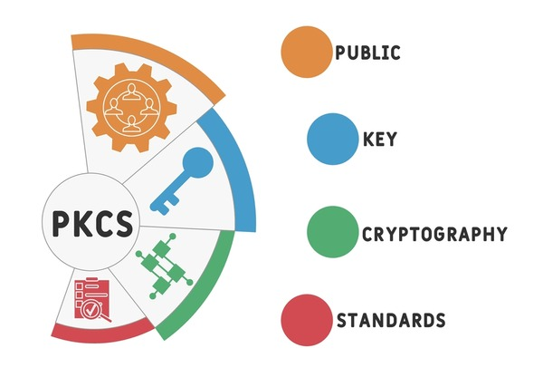
Public Key Cryptography Standard (PKCS)
set of standards initially developed by RSA Security in the 1990s and later adopted and expanded upon by other organizations like IETF and NIST.
cover various aspects of public-key cryptography and provide specifications for cryptographic algorithms, formats, protocols, and APIs

Slide 36
PKCS Standards
PKCS#1: Defines the RSA encryption algorithm and various cryptographic schemes based on it, including digital signatures and key exchange.
PKCS#3: Specifies the Diffie-Hellman key agreement algorithm for establishing shared secrets between parties
PKCS#5: Describes techniques for password-based encryption, including key derivation and key wrapping
PKCS#8: Specifies a syntax for private key information. It defines a way to store private keys in a portable format.
PKCS#10: Describes a syntax for certificate requests. It's used when someone wants to apply for a digital certificate from a certificate authority (CA).

Slide 37
PKCS Standards
PKCS#11: Also known as Cryptoki, it's a platform-independent API for cryptographic tokens and devices, such as hardware security modules (HSMs) and smart cards.
PKCS#12: Defines a file format commonly used to store private keys with accompanying public key certificates, protected with a password-based symmetric key.
PKCS#13: Defines Elliptic Curve Cryptography (ECC) standard
PKCS#15: Specifies a way to store cryptographic information on cryptographic tokens, such as smart cards, in a standard way.

Slide 38
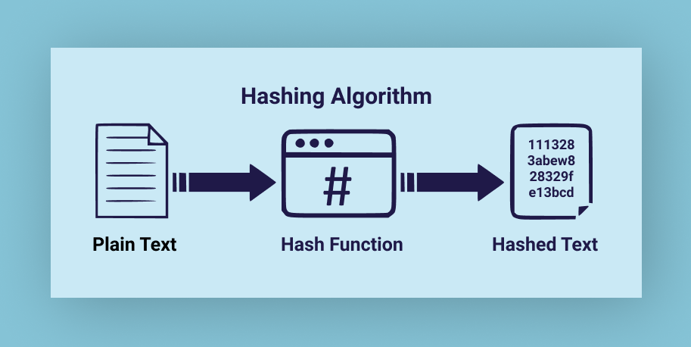
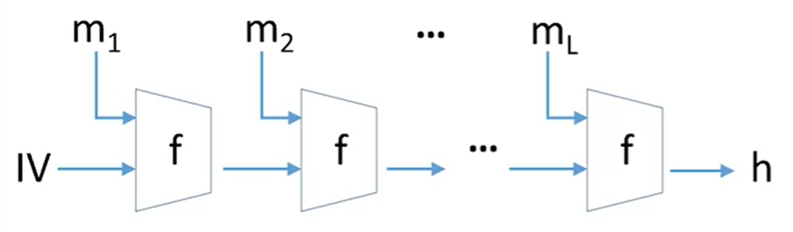
Hash Functions
One way encryption process applied to the original plaintext to generate a fixed-size ciphertext.
a.k.a. digest
Deterministic function – it produces of identical size regardless of the input size.
Properties
Collision Resistance: Difficulty of finding two different inputs that hash to the same output.
Pre-image Resistance: Given a hash value, it should be computationally infeasible to find the original input.
Second Pre-image Resistance: Given an input, it should be difficult to find a different input with the same hash.
Non-Reversibility: It should be computationally infeasible to reverse the hash function.
Examples : MD5, SHA1, SHA256 etc.

Slide 39

Pretty Good Privacy (PGP) and GNU Privacy Guard (GPG)
Key Features
Privacy: PGP ensures the privacy of data by encrypting it, allowing only authorized recipients to decrypt and access the content.
Authentication: PGP allows users to digitally sign their messages or files, verifying the sender's identity and ensuring data integrity.
Versatility: PGP can be applied in various contexts, including email encryption, file protection, and secure data transfer.
OpenPGP: PGP has influenced open-source implementations and standards like OpenPGP, fostering interoperability and innovation in secure communication.
End-to-End Encryption: PGP ensures end-to-end encryption, meaning data is encrypted on the sender's side and decrypted on the recipient's side, minimizing the risk of interception during transmission.
GPG, or GNU Privacy Guard, is an open-source cryptographic software tool designed for secure data encryption, digital signatures, and privacy protection. Developed as a free alternative to PGP (Pretty Good Privacy)
GPG provides robust encryption and authentication capabilities for safeguarding digital communication and data.
PGP, or Pretty Good Privacy, is a widely-used data encryption and decryption program that provides robust cryptographic privacy and authentication for secure communication.
developed by Phil Zimmermann in 1991
PGP utilizes both symmetric and asymmetric cryptography to secure emails, files, and digital data.

Slide 40
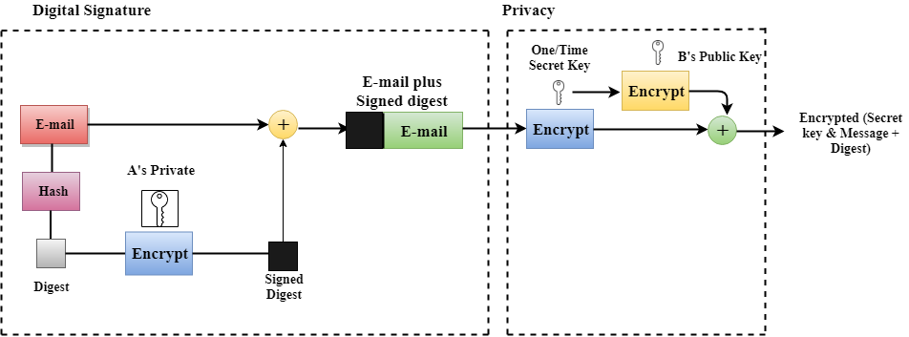
PGP – Sender

Slide 41
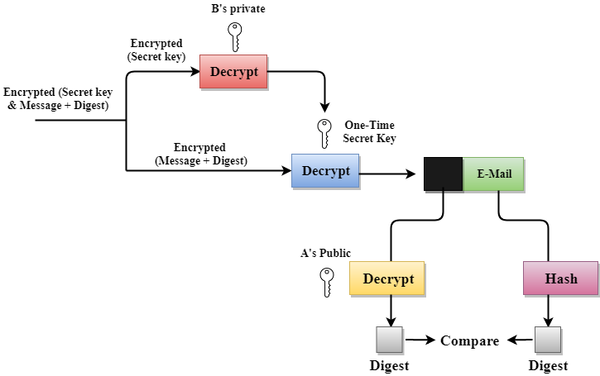
PGP – RECEIVER

Slide 42
Case Study – TLS 1.2
Server listens for new connections on port 443.
Client connects to port 443 and initiates the handshake process with a ClientHello message to the server.
This message contains the TLS versions and cipher suites the client supports, and a 32-byte random number known as Client Random.
Server says “hello” back with a ServerHello message.
The server selects a cipher and the TLS version from the list provided by the client, then generates a different 32-byte random number known as Server Random and sends it all back along with the server’s own SSL certificate.
Client uses the SSL certificate to verify the server’s identity.
SSL certificates contain a public key generated by the server and a digital signature signed with the private key of a trusted third party known as a certificate authority (CA). Most web browsers and operating systems come bundled with public keys from trusted CAs, which are used to verify that the CA issued the certificate.
The client verifies the server has the matching private key to the certificate through ClientKeyExchange.
The client generates the pre-master secret (a 48-byte random number) and encrypts it with the server’s public key obtained from the certificate. If the server is the true owner of the certificate, it must be able to decrypt the message and obtain the original pre-master secret.

Slide 43
Case Study – TLS 1.2
Server decrypts the pre-master secret.
Now both the server and client have the pre-master secret, the Server Random, and the Client Random. They can use that to derive the master secret using the previously agreed cipher and arrive at the same (symmetric) key, which will become the session key once both parties verify their keys match.
Client sends a ChangeCipherSpec message.
This indicates that the client is ready to create the session key and start communicating through an encrypted tunnel using that key.
Client proves to server it has the correct keys.
The client hashes all handshake records up to that point, encrypts them with the session key, and sends them to the server. If the server generates the correct key, it will be able to decrypt that message and verify the record hashes (which the server can independently generate).
Server proves to the client that it has the correct keys.
The server does the same thing and sends it to the client.
A secure connection is established. If both keys match, the TLS handshake is complete.
Sample Packet Capture: https://www.cloudshark.org/captures/26fa735868c1

Slide 44
Case Study – TLS 1.3
Server listens for new connections on port 443.
Client connects to port 443 and initiates the handshake process with a ClientHello message to the server.
Since the list of cipher suites was vastly reduced in TLS 1.3 (from 37 to 5), the client assumes the server is going to use one of the five. It proactively calculates a key pair for each of the cipher suites and sends it to the server along with the protocol version.
Server calculates the key session.
With the client’s key share, the server is able to generate the session key.
Server says “hello” back with a ServerHello message.
The server generates its own key share and sends it over to the client, so it also can generate the session key, along with the server’s encrypted SSL certificate (using the session key created on #3).
Client generates master secret, and a secure connection is established.
The client receives the server’s key share and calculates the session key. It decrypts and verifies the server’s certificates, and if everything is good, the handshake is complete.
Sample Packet Capture: https://www.cloudshark.org/captures/a044d58b77aa

Slide 45
Case Study – SSH Authentication
Key Generation
The first step is to generate an RSA key pair on the client machine. This pair includes a public key and a private key.
The private key must be kept secret and securely stored on the client machine.
Key Distribution
The client's public key is typically copied to the server to which the client wants to connect. This can be done manually or using a key management system.
User Authentication
When a user initiates an SSH connection to the server, the server responds by requesting authentication.
The client responds by providing its public key to the server as part of the authentication process.
Server Authentication
To ensure the authenticity of the server, the server provides its host key to the client during the initial connection attempt.
The client checks whether the server's host key is trusted and matches a known host key.

Slide 46
Case Study – SSH Authentication
Client Authentication
If the server's host key is verified, the client proceeds with authentication using its RSA key pair.
The client signs a random challenge sent by the server using its private key and sends the signed challenge back to the server.
Server Verification
The server verifies the client's signature using the stored public key.
If the signature is valid and the client's public key is trusted, the server grants access to the client.
Authenticated Session
Once authenticated, an encrypted and secure SSH session is established between the client and the server.
All data exchanged between the client and server is encrypted using symmetric encryption for the duration of the session.
Session Termination
When the session is complete, the encrypted connection is terminated.

Slide 47
Case Study - Outlook Encryption/Decryption and Digital Signatures
Creating and Managing Digital Certificates
To encrypt and digitally sign messages, Outlook requires digital certificates associated with the email sender and recipient(s).
Outlook relies on the user's personal digital certificates, which include a public key (used for encryption and verification) and a private key (used for decryption and signing).
Users need to obtain digital certificates from trusted Certificate Authorities (CAs) or generate self-signed certificates if applicable.
Sending an Encrypted Message
When composing an email, the sender can choose to encrypt the message by clicking on the "Encrypt" button in the message composition window.
If the recipient's digital certificate is available in the sender's Outlook address book or is publicly available through LDAP (Lightweight Directory Access Protocol), Outlook will use the recipient's public key to encrypt the message.
Once encrypted, the message is sent securely over the internet.

Slide 48
Case Study – Outlook Encryption/Decryption and Digital Signatures
Digital Signing
When composing an email, the sender can choose to digitally sign the message by clicking on the "Sign" button in the message composition window.
Outlook uses the sender's private key to create a digital signature for the message. This signature is attached to the email.
Recipients can use the sender's public key (which should be included in the sender's digital certificate) to verify the signature's authenticity and ensure the message has not been tampered with in transit.
Recipient's Experience
When a recipient receives an encrypted email, Outlook automatically decrypts the message using the recipient's private key (if available) or prompts the user for their private key passphrase or PIN.
For digitally signed messages, Outlook displays a "This message was signed" notification, allowing the recipient to verify the sender's digital signature.

Slide 49
Future Trends
Post-Quantum Cryptography (PQC): As quantum computing continues to advance, traditional cryptographic algorithms like RSA and ECC (Elliptic Curve Cryptography) may become vulnerable to quantum attacks. Post-Quantum Cryptography (PQC) aims to develop algorithms that are secure against quantum adversaries. Expect continued research and standardization efforts in this area.
Homomorphic Encryption: Homomorphic encryption allows computations to be performed on encrypted data without decrypting it first, preserving privacy. Future trends may involve making homomorphic encryption schemes more efficient and practical for real-world applications, enabling secure cloud computing, data analysis, and privacy-preserving machine learning.
Zero-Knowledge Proofs (ZKPs): Zero-Knowledge Proofs (ZKPs) allow one party to prove to another party that they know a secret without revealing any information about the secret itself. ZKPs have applications in privacy-preserving authentication, identity management. Expect further research and development in ZKP protocols and their applications.

Slide 50
Future Trends
Secure Multiparty Computation (MPC): Secure Multiparty Computation (MPC) enables multiple parties to jointly compute a function over their inputs while keeping those inputs private. Future trends may focus on making MPC protocols more efficient, scalable, and easier to deploy, with applications in privacy-preserving data analysis, collaborative machine learning, and secure auctions.
Fully Homomorphic Encryption (FHE): Fully Homomorphic Encryption (FHE) allows arbitrary computations to be performed on encrypted data, opening up possibilities for end-to-end encryption and privacy-preserving cloud computing. Expect advancements in FHE schemes to improve efficiency and usability, enabling broader adoption in practical applications.

Slide 51
Thank you

